Slide 1
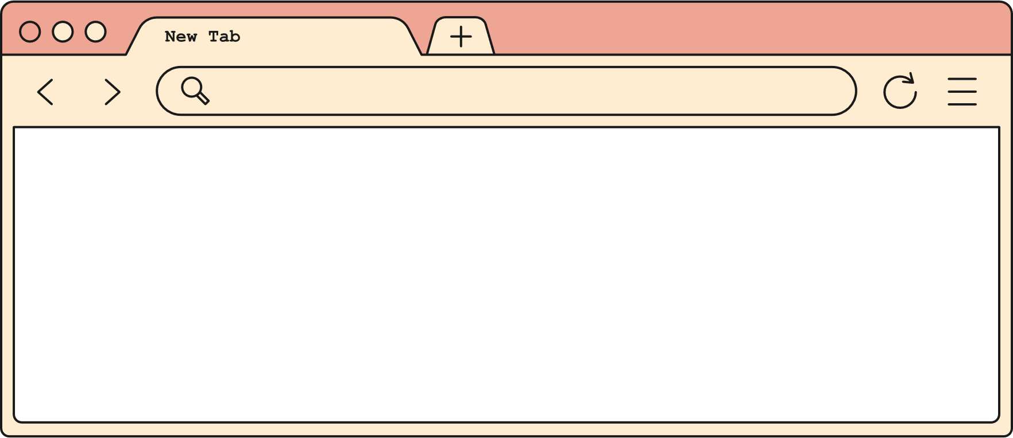
EV BATTERY
Maya

Slide 2
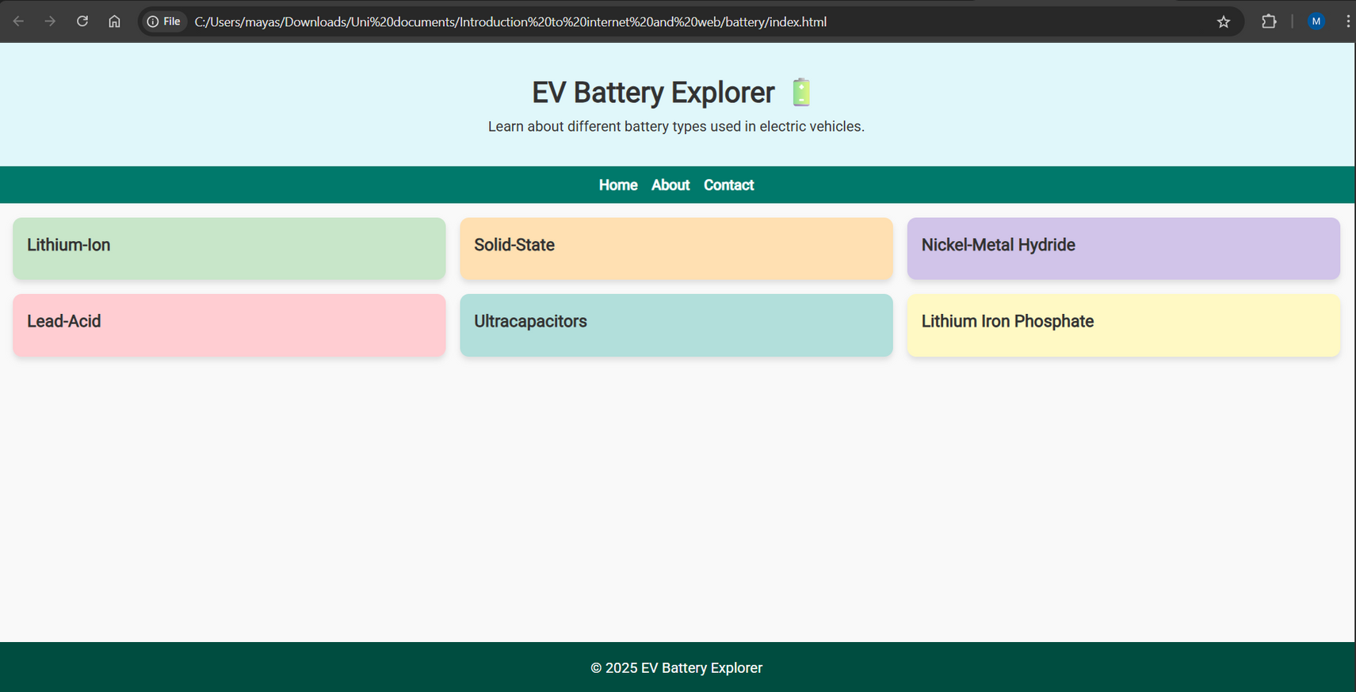
Planned design vs Final design

Slide 3
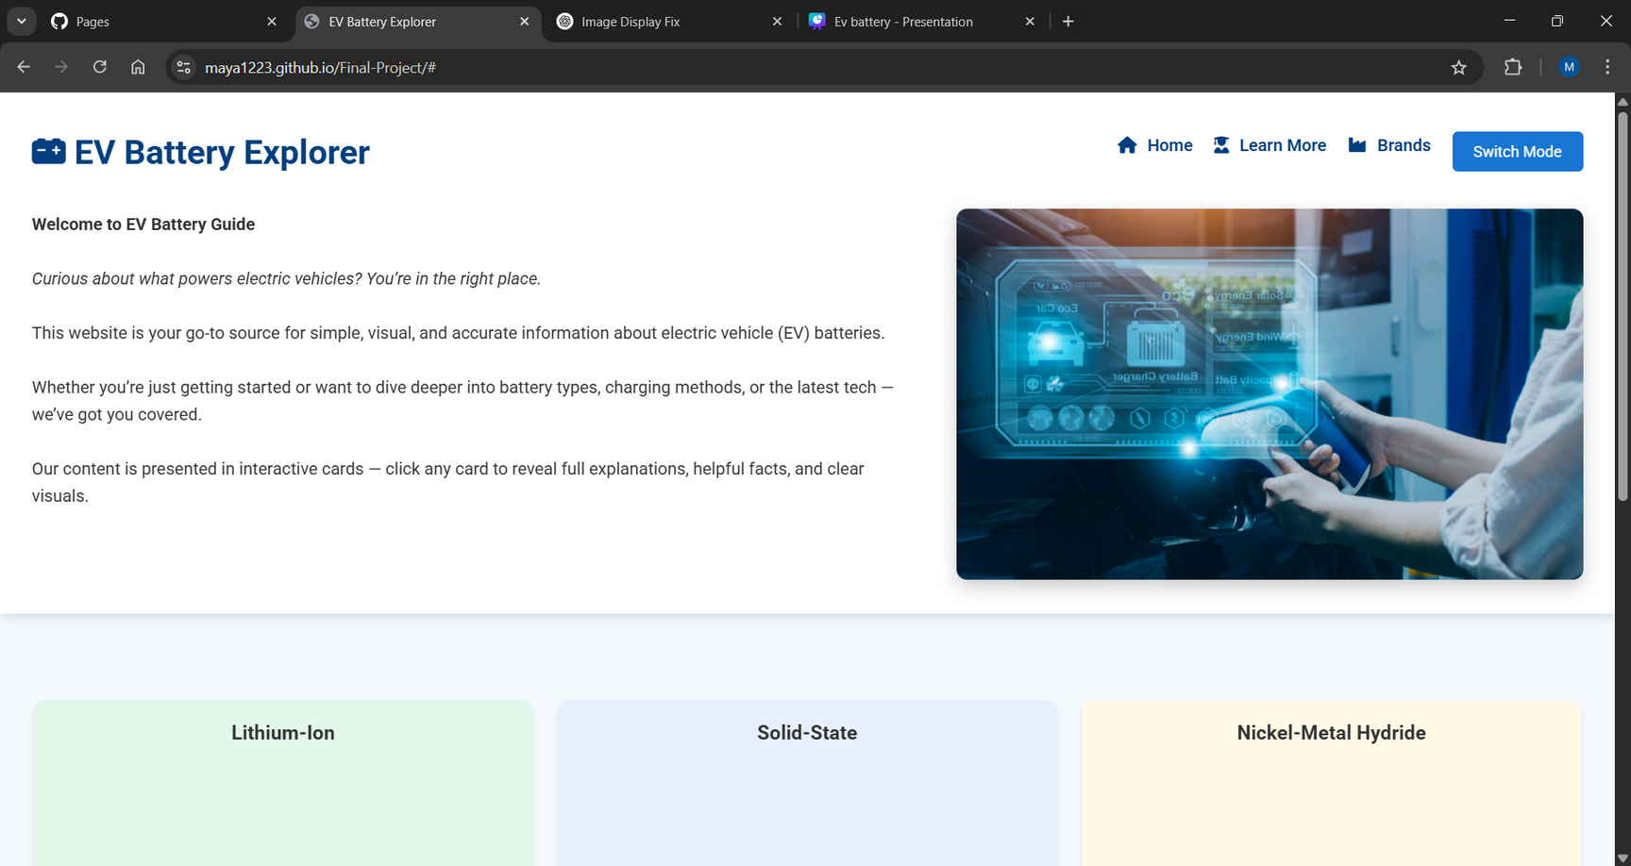
Planned design vs Final design
https://maya1223.github.io/Final-Project/

Slide 4
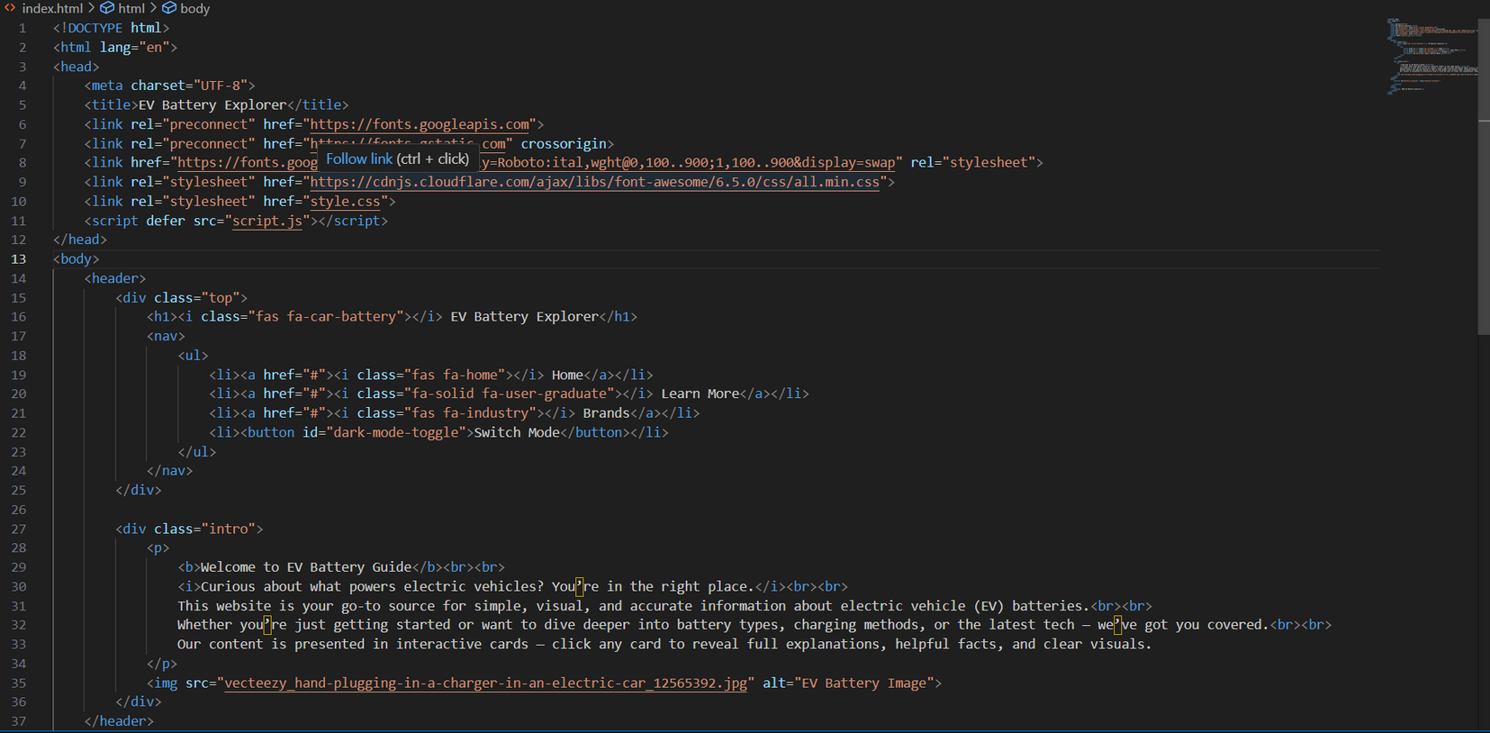
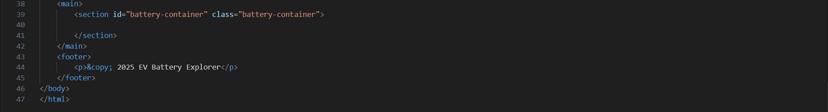
HTML

Slide 5
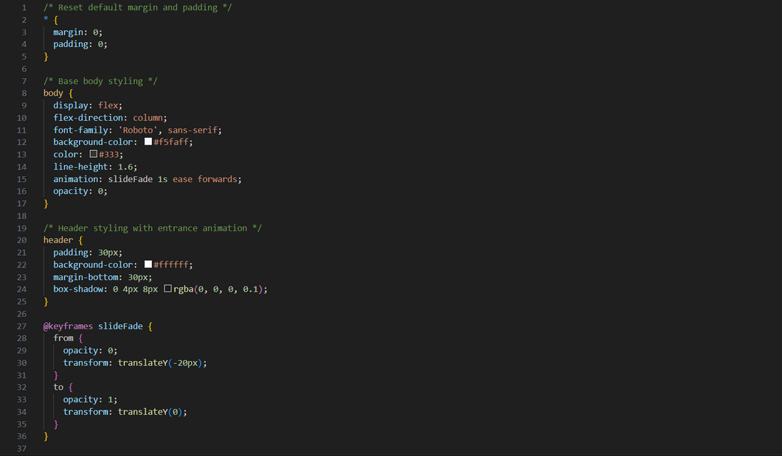
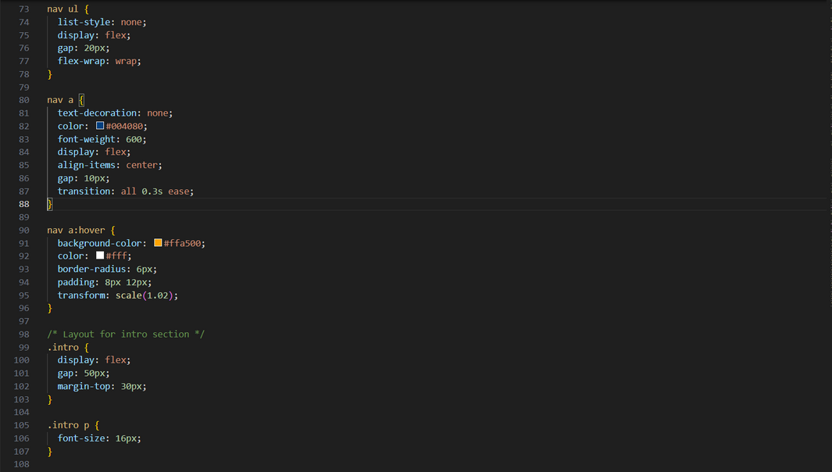
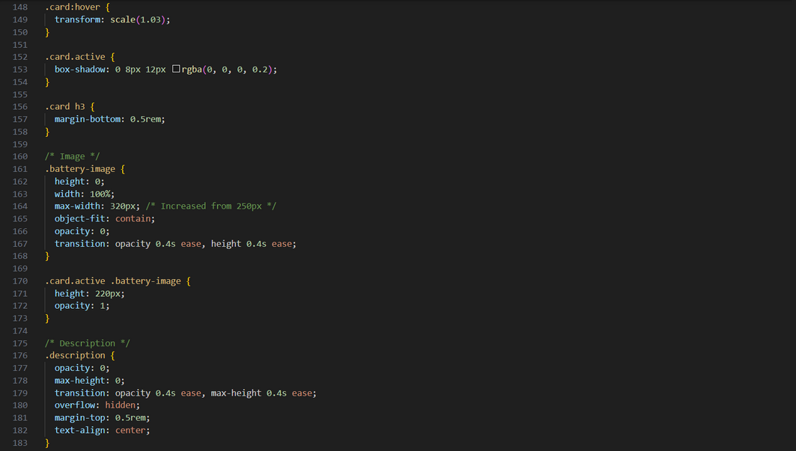
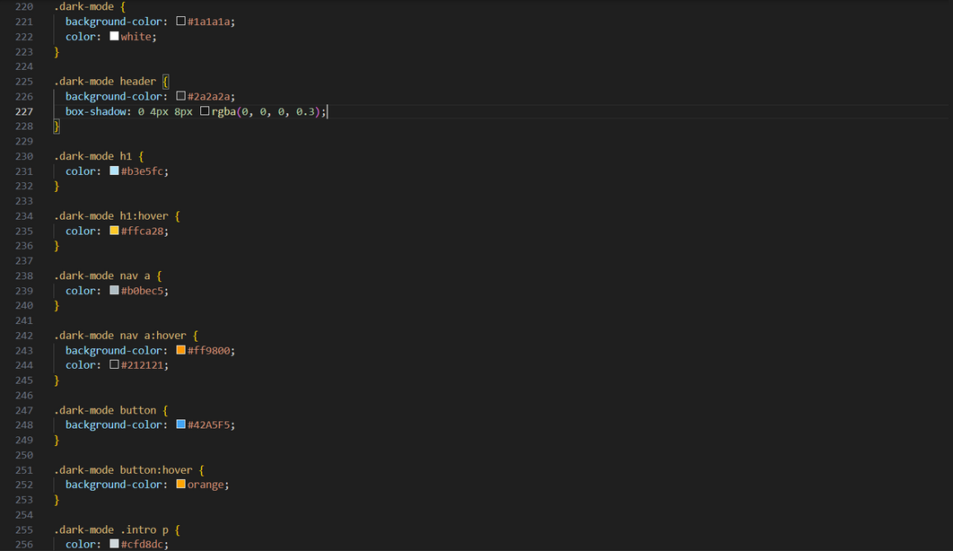
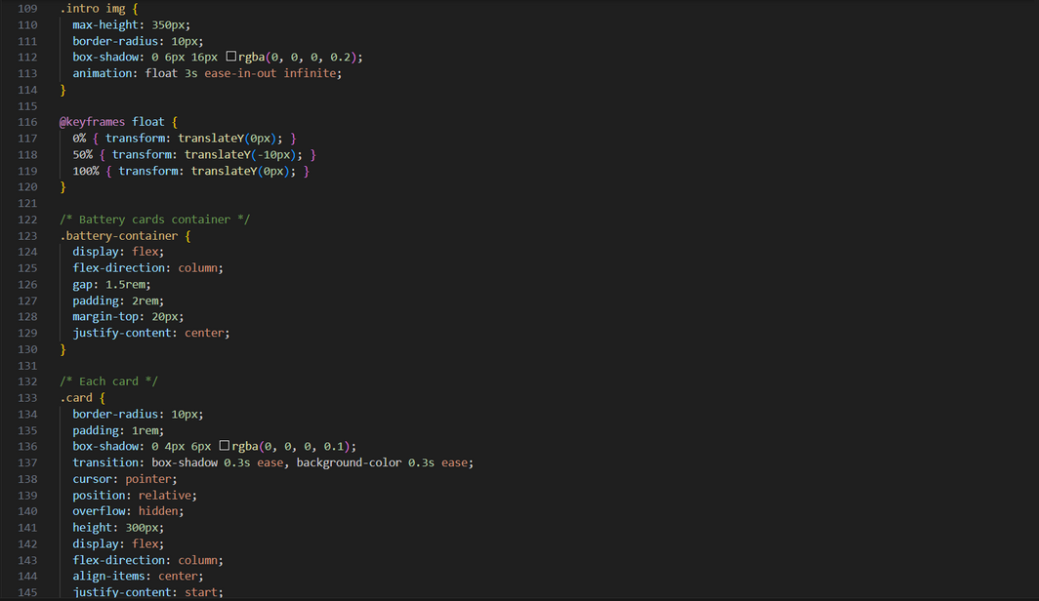
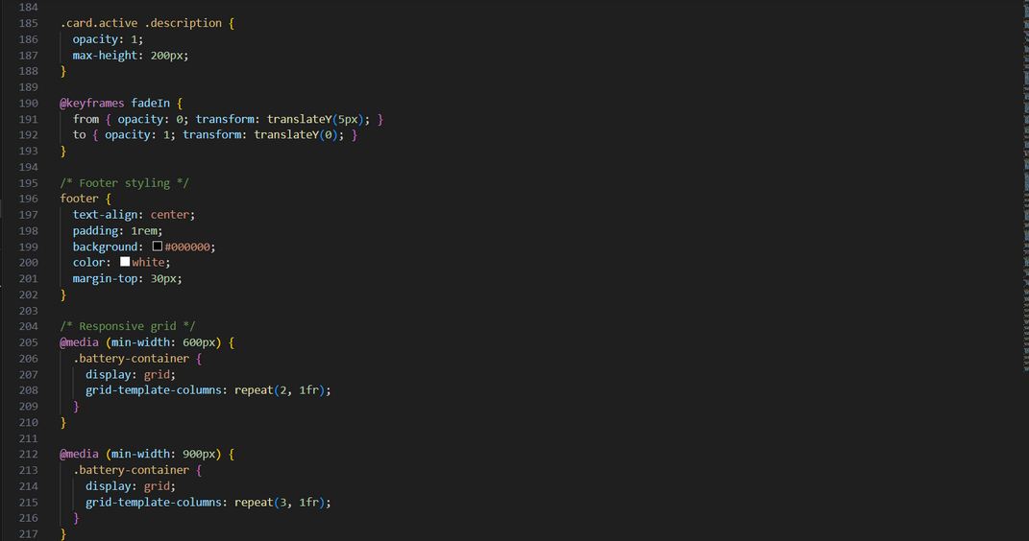
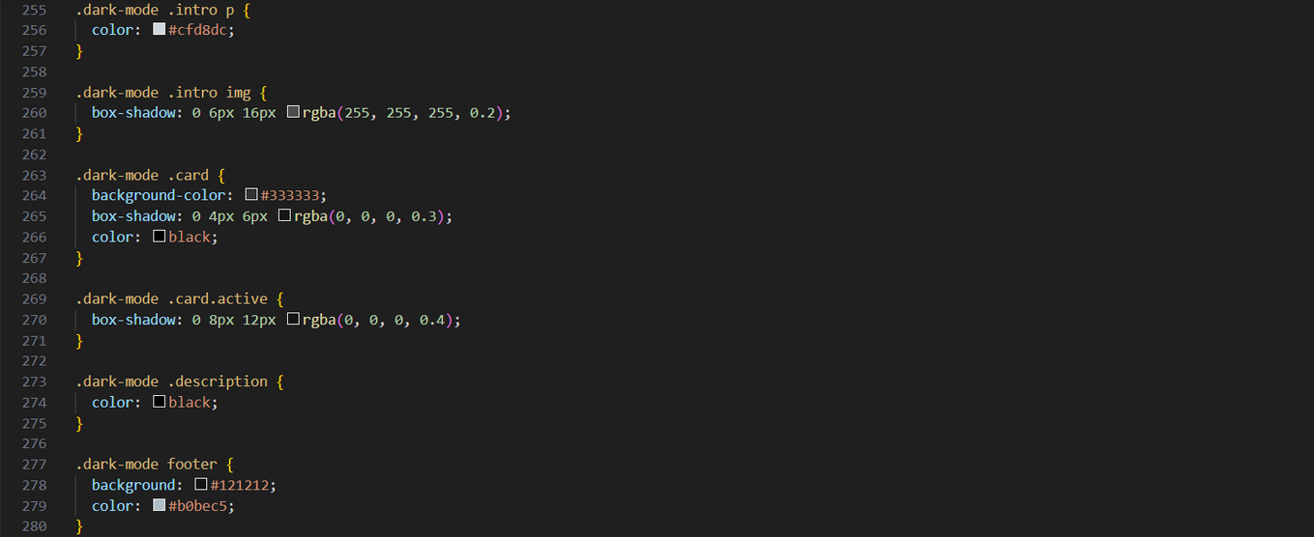
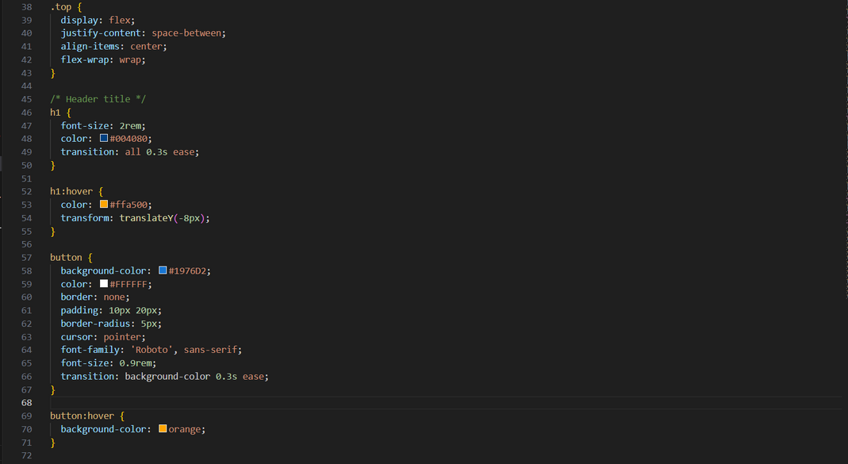
CSS

Slide 6
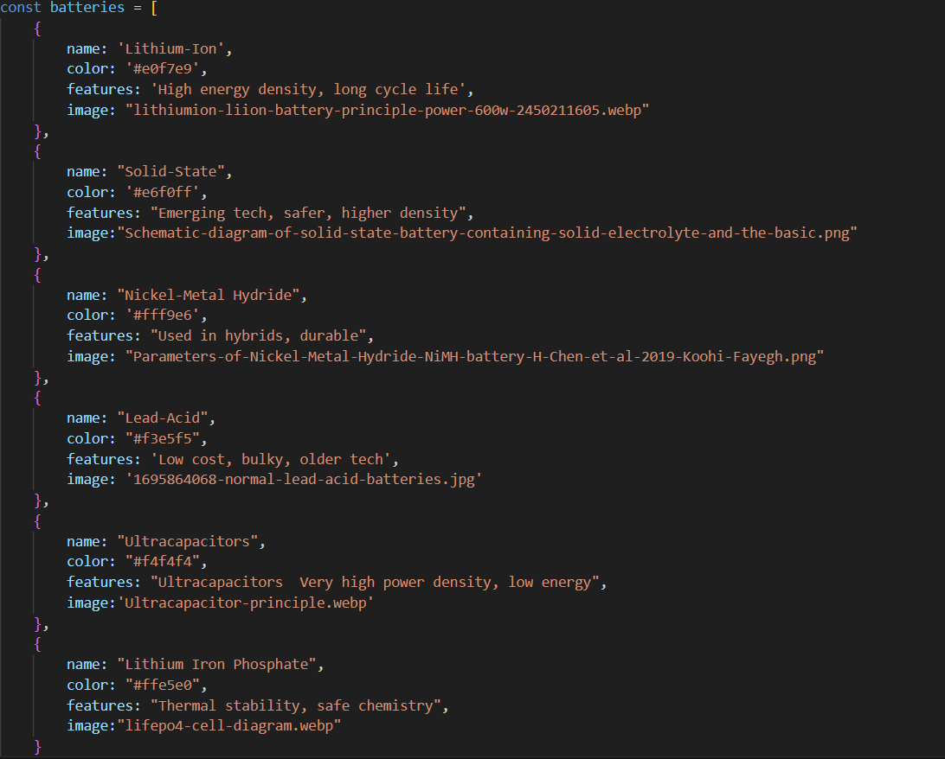
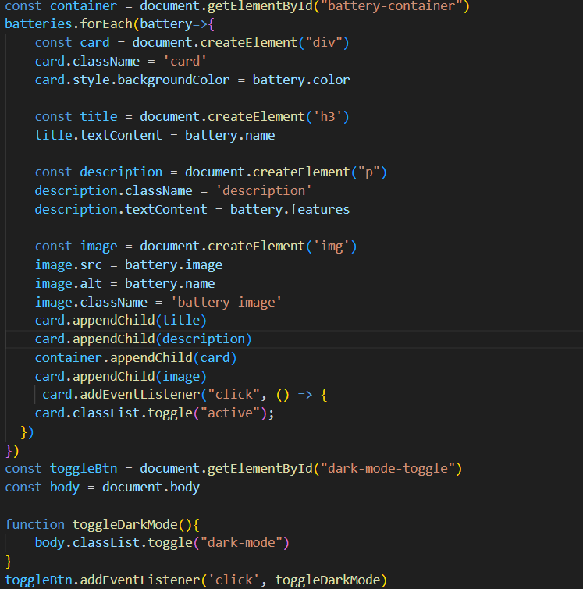
Javascript

Slide 7

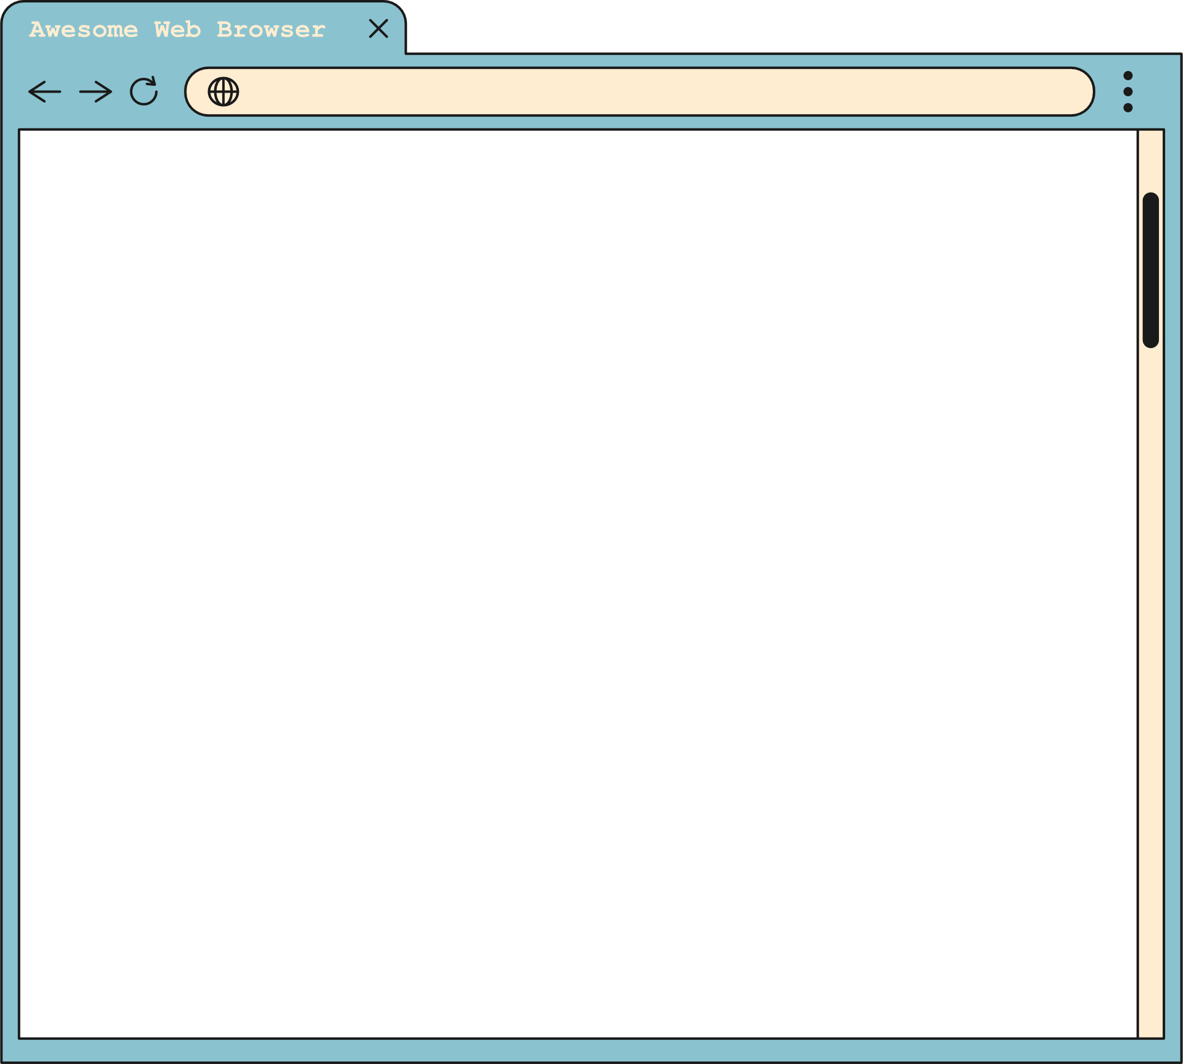


QUESTION #1
What are the problems that I faced
https://www.reallygreatsite.com
The design
The Cards toggling
The small screens layout

Slide 8
QUESTION #2
What is next
https://www.reallygreatsite.com
I will add youtube video for each battery as an iframe and add infographic to compare between batteries so that users can learn more about the batteries in the navigation link “Learn more”
2. I will search for the Car brands that started to use these batteries in their electrical vehicles.

Slide 9
Thank you

